Slide 1
CONCEPTUAL DESIGN PROJECT 3
Professor: Ashish Seth

Slide 2
‘Gravity’ team members
U1910071
U1910278
Naimov Fayyoz
Mirsagatova Sitora
U 1910232
U1910245
Kholmurodov Dilshodjon
Zaynobiddinova Zebiniso
U 1910275
Komiljonov Boburjon

Slide 3
CONTENTS
GANTT CHART
01
CONCEPTUAL DESIGN
02
DECISION-MAKING MATRIX
03
FINAL DESIGN
04
EVALUATION
05

Slide 4
01.
GANTT CHART

Slide 5
16.04.2020 | 18.04.2020 | 20.04.2020 | 21.04.2020 | 28.04.2020 | 2.05.2020
Discussing the given project |  | First models of the chain reaction | Adding some chains to the product |  | Checking all the parts of ppt and report
 | Finding some ways to create a chain reaction |  |  | Start working with ppt and report
Trying to understand the problem |  | Discussing plus and minus sides of the product | Comparing all designs |  | Finishing all parts of final idea
Choosing team leader | Discussing some possible ways to do the chain reaction | Find some solutions to avoid deficiencies | Coming up to final idea | Dividing tasks among team members | Report and ppt done

Slide 6
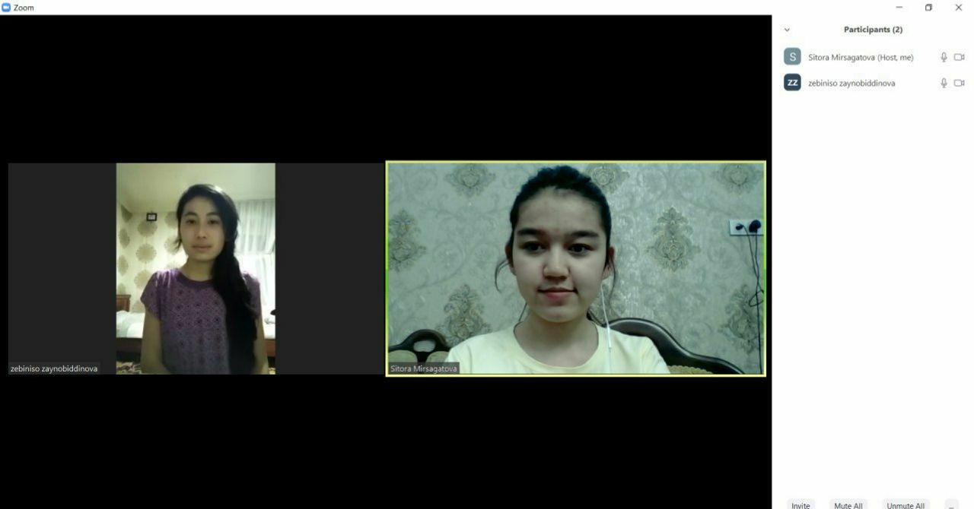
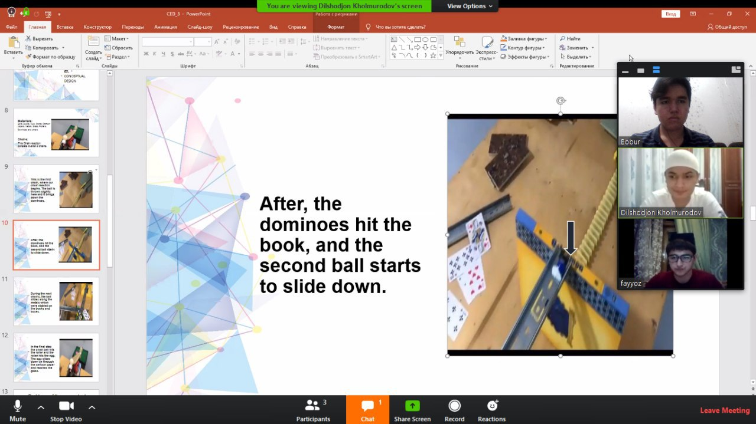
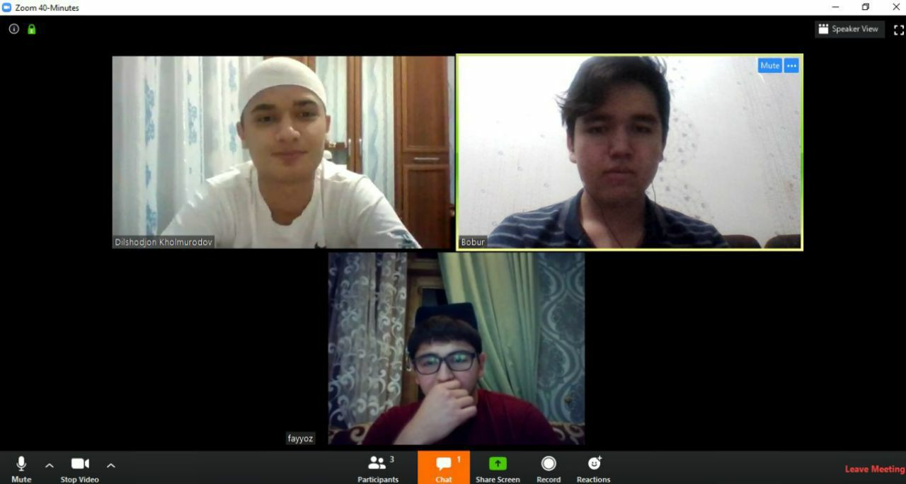
Photos of online meetings:

Slide 7
02.
CONCEPTUAL DESIGN

Slide 8
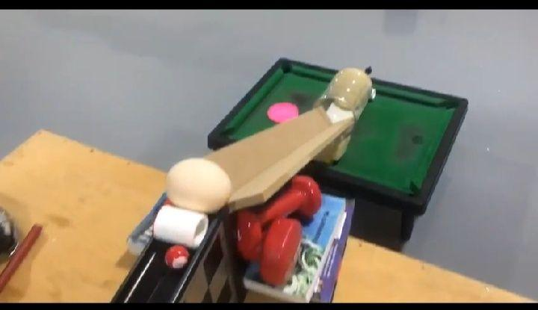
Materials: Balls, Books, Toys, Cards, Cartoon papers, metals, Glass, Rollers, Dominoes and others
Chains:
This Chain reaction consists overall 5 chains.

Slide 9
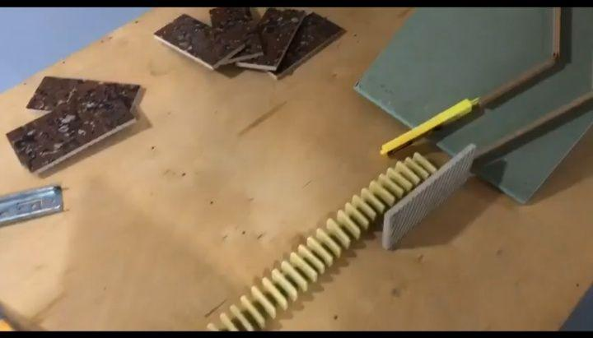
This is the first chain, where our chain reaction begins. The ball is thrown slightly here and it brings down the dominoes.

Slide 10
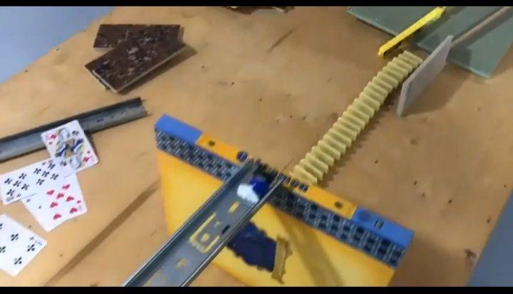
After, the dominoes hit the book, and the second ball starts to slide down.

Slide 11
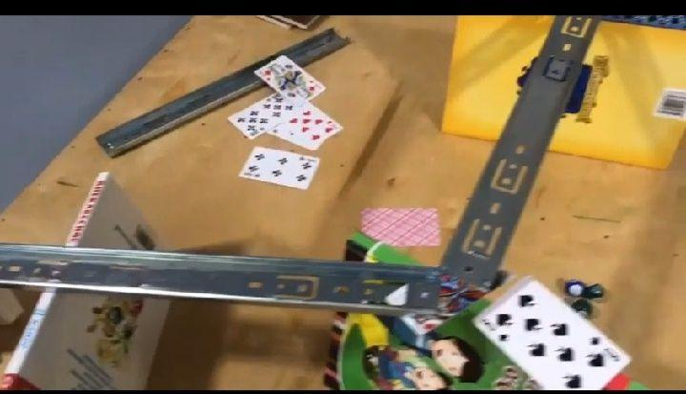
During the next chains, the ball slides along the metals which were stabled on the books and boxes.

Slide 12
In the final step the small ball hits the roller and the roller hits the egg. The egg slides down on through the cartoon paper and reaches the glass.

Slide 13
Problems of the conceptual design and ways to solve them
In some chains of the conceptual design, the balls may not move and this stops the process. To solve this, we tried to use some tubes which connects upward and downward parts of the chain. Additionally, we used a toy, excavator, to lift the ball to the to the up. Added new chains can be

Slide 14
03.
DECISION-MAKING MATRIX

Slide 15
Requirements: | Significance | First Conceptual Design | Final Design
Height of the egg from the floor
Correlation of chains
Number of chains
Egg is undamaged
Sum: | 18 | 10 | 20
-Great (5) -Normal (3) -Poor (1)

Slide 16
04.
FINAL DESIGN

Slide 17
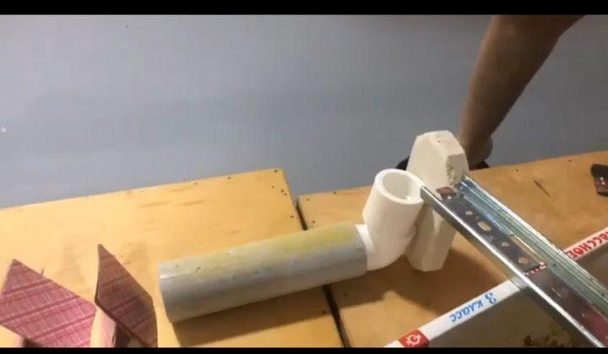
Step by step explanation
First chain
The ball will be thrown and it slides along the way, causes dominoes to fall
Second chain
Dominoes push the book. Then the next ball begins to move
Third chain
Ball slides along the way made with metals.
Fourth chain
The ball comes along the way, and falls into tube.

Slide 18
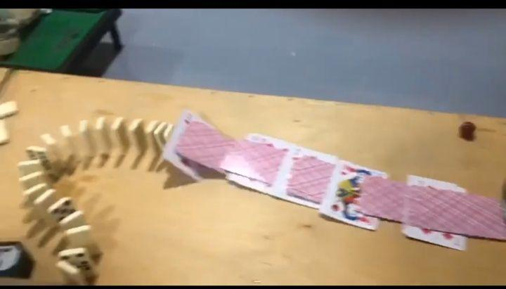
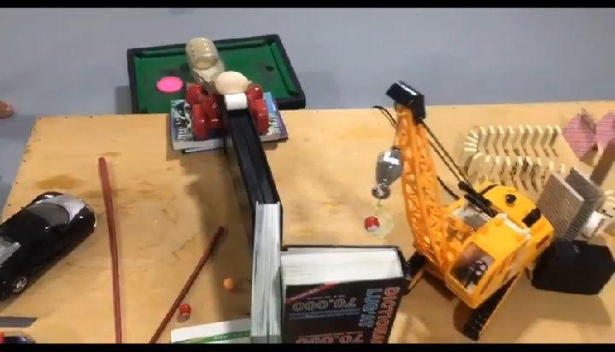
Step by step explanation
Fifth chain
Ball comes from the tube and causes the cards to fall, the cards causes the dominoes to fall
Fifth and sixth chain
Dominoes push the wood which makes the excavator to work. Excavator throws the ball, the ball moves along the way made with book and box
Final chain
In the final chain, the red ball pushes the roller and the roller pushes the egg. The egg slides down along the way made of the cartoon paper and reaches the glass. The egg will not get damaged during the whole process
The height of the starting point is
35 sm.
The distance from starting point to the end is 2 meters
The egg is around 80 cm from the ground

Slide 19
05.
EVALUATION

Slide 20
Some problems of the conceptual design was successfully solved in the final design Chain reaction was done successfully using household items and toys Materials were chosen correctly and placed with clear and logical order Creativity lead to create a chain reaction which fulfills the purpose

Slide 21
THANK YOU FOR YOUR ATTENTION
Wish you health!!!

